Slide 1
COVID-19 Data Update December 2, 2020 Knox County Board of Health

Slide 2
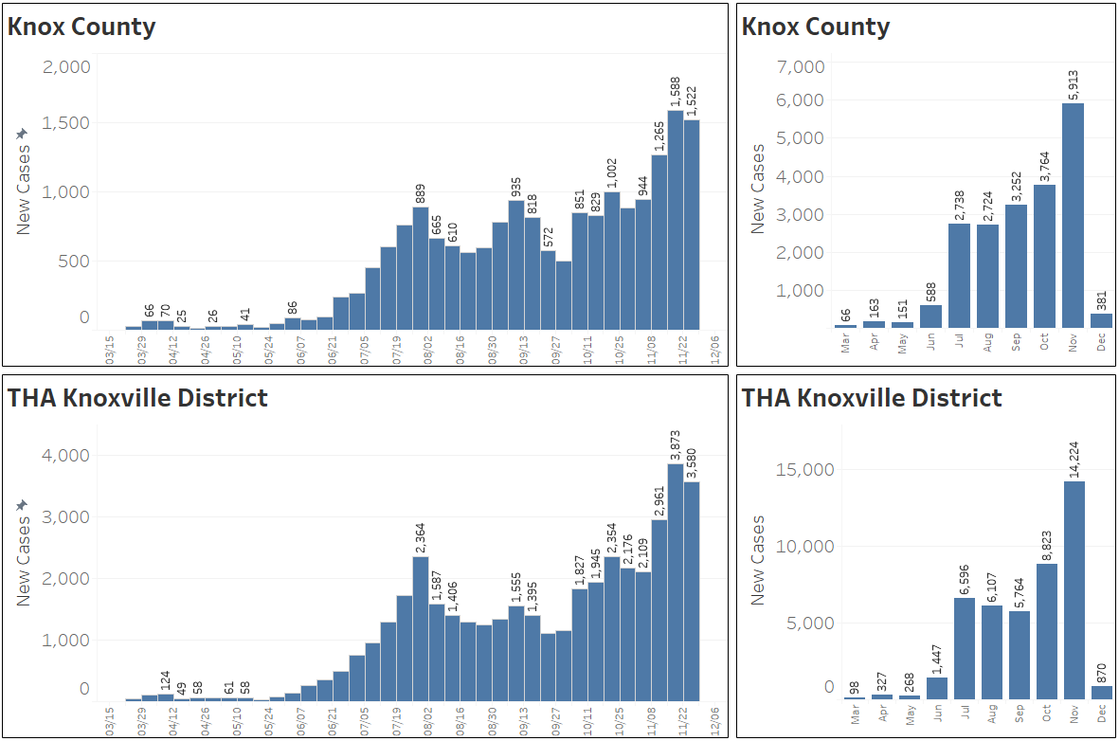
New Cases by Week/Month
THA Knoxville District Counties
Knox Blount
Sevier Cocke
Jefferson Grainger
Hamblen Claiborne
Union Campbell
Anderson
Data from the Tennessee Department of Health as of December 1, 2020

Slide 3
“Big 4” Comparison
Data from the Tennessee Department of Health and Tennessee State Data Center as of December 1, 2020

Slide 4
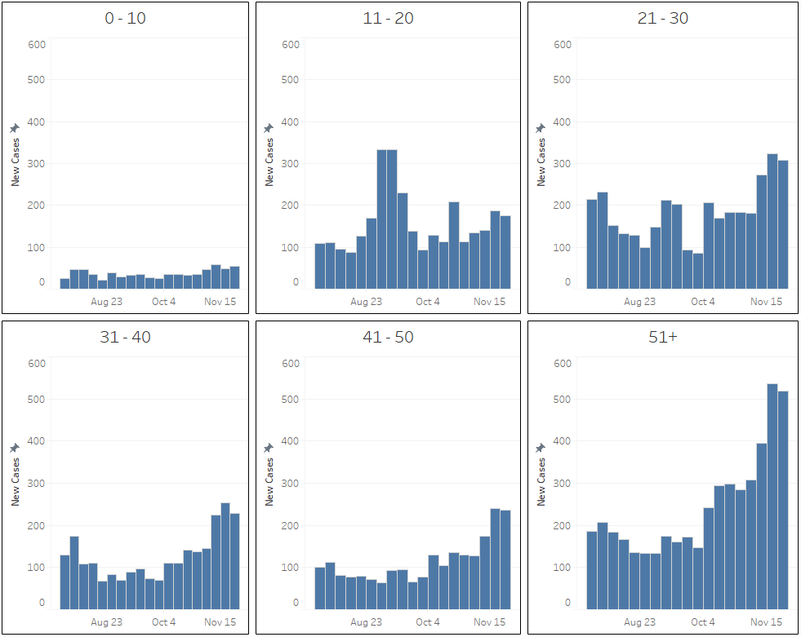
Knox County New Cases Age Demographics
Data from the Tennessee Department of Health as of December 1, 2020

Slide 5
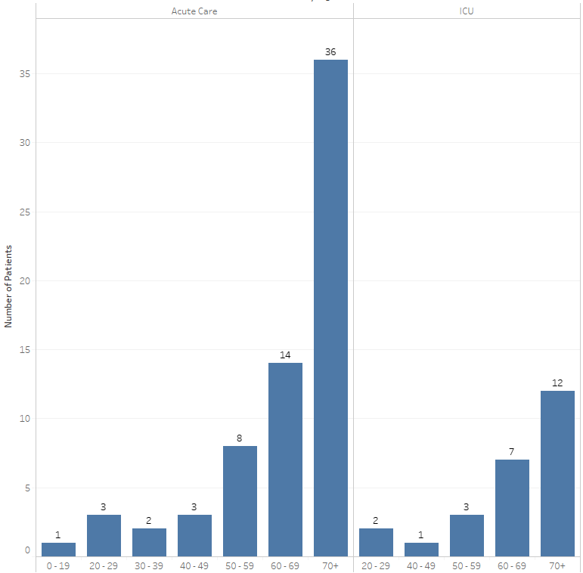
UTMC COVID-19 Inpatient Age Demographics
Data from the University of Tennessee Medical Center as of December 1, 2020

Slide 6
Knox County Positivity Rate
Due to irregularities in TDH test result reporting (which resulted in enormous single day positivity rates), switched from average of the last 7 days’ positivity rate to the sum of the last 7 days’ positive tests divided by the last 7 days total tests resulted.
Data from the Tennessee Department of Health and Tennessee State Data Center as of December 1, 2020

Slide 7
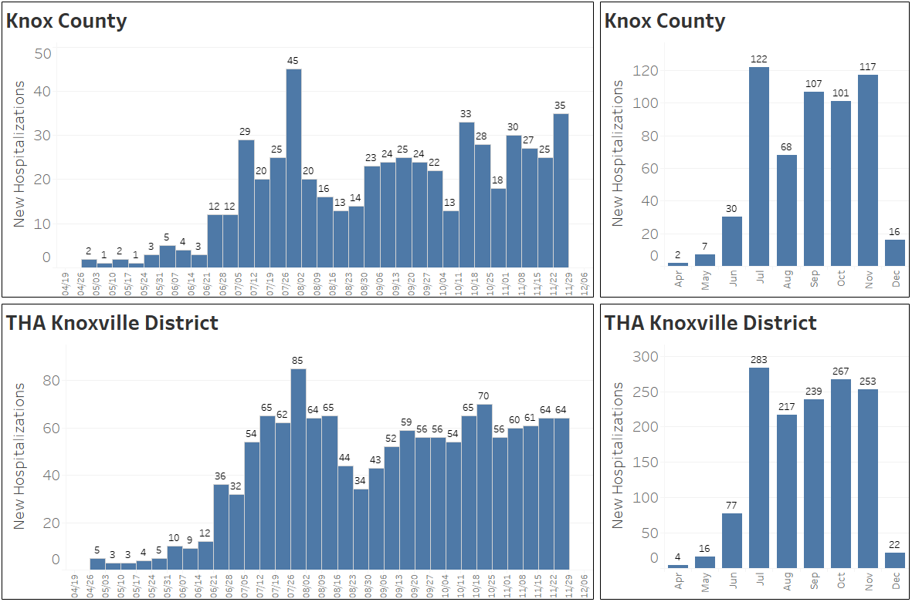
Hospitalizations by Week/Month
TDH reported hospitalizations continue to be delayed by days or weeks.
THA Knoxville District Counties
Knox Blount
Sevier Cocke
Jefferson Grainger
Hamblen Claiborne
Union Campbell
Anderson
Data from the Tennessee Department of Health as of December 1, 2020

Slide 8
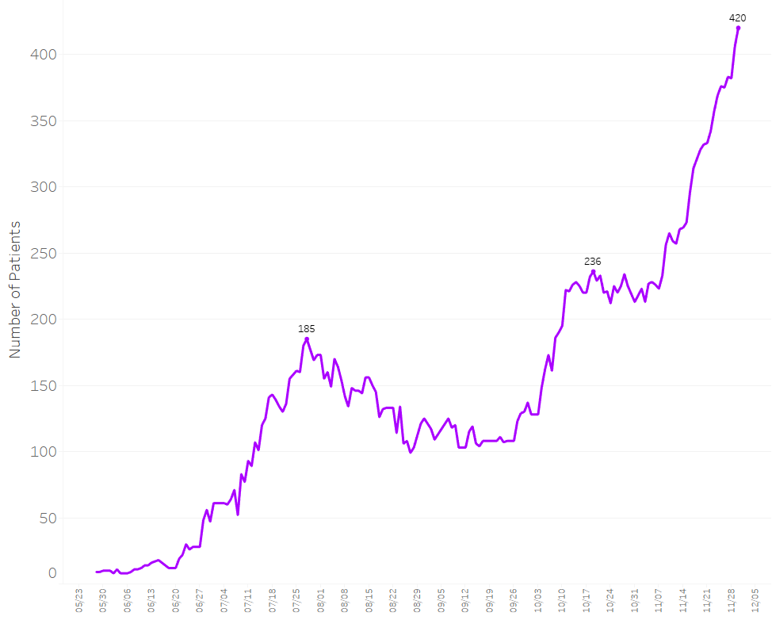
THA Knoxville District Census
THA Knoxville District Counties
Knox Blount
Sevier Cocke
Jefferson Grainger
Hamblen Claiborne
Union Campbell
Anderson
Data from the Tennessee Healthcare Resource Tracking System as of November 30, 2020

Slide 9
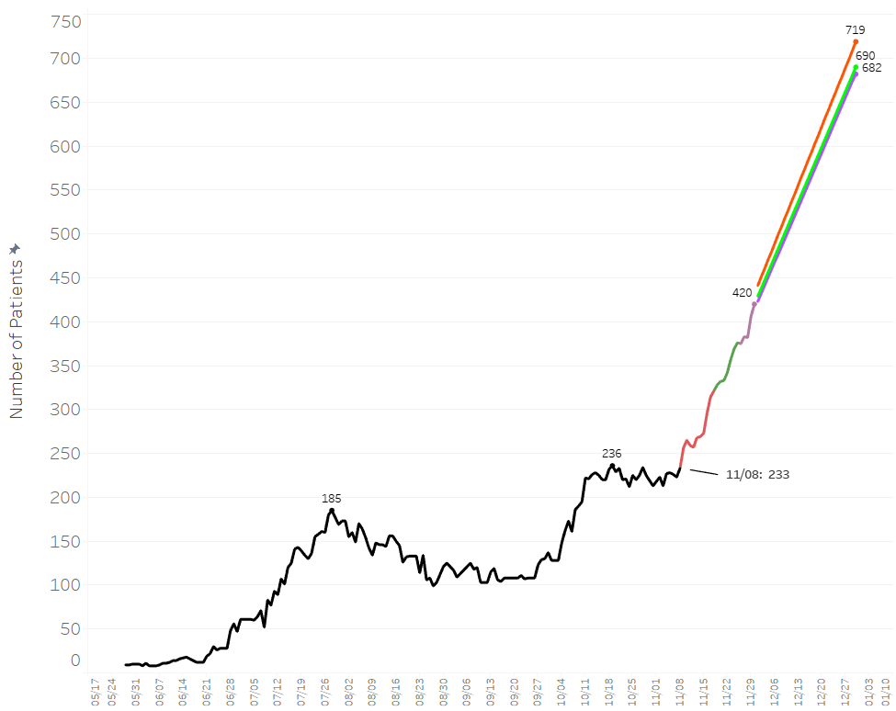
THA Knoxville District Projection Comparison
November 18 Trendline
November 25 Trendline
November 30 Trendline
THA Knoxville District Counties
Knox Blount
Sevier Cocke
Jefferson Grainger
Hamblen Claiborne
Union Campbell
Anderson
Data from the Tennessee Healthcare Resource Tracking System as of November 30, 2020

Slide 10
Regional Hospital Capacities
Format before December 2, 2020
Format as of December 2, 2020

