Slide 1
Report to
Knox County
Board of Health
April 21, 2021

Slide 2
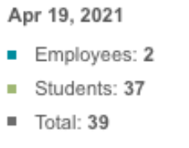

Slide 3
